Slide 1
Poisson random variable:
Queues and meteorites

Slide 2
Events occurring over a period of time
Examples
Arrival of a person to a booking counter queue
Arrival of a visitor to a website
Emission of a particle by radioactive decay
A meteorite entering earth’s atmosphere
What is common to above examples?
Arrival rate: can be assumed to be constant
Given one arrival, the time for next arrival can be assumed to be independent
Under above assumptions, the number of arrivals in a fixed period of time becomes a Poisson random variable.

Slide 3
Example: Radioactive decay
In 2608 time intervals of 7.5 seconds each, emission of alpha particles is as follows:
#particles → 0 1 2 3 4 5 6 7 8 9 10
#times → 57 203 383 525 532 408 273 139 45 27 16
fraction →0.022 0.078 0.147 0.201 0.204 0.156 0.105 0.053 0.017 0.0104 0.0061
Emission rate = (total number of particles)/2608 = 3.8673 (λ of Poisson)
Time of next emission: independent of past
Poisson model: Prob(#particles = k) = e^{-λ} λ^{k} / k!
Fraction (given above) should be close to probability under Poisson model.

Slide 4
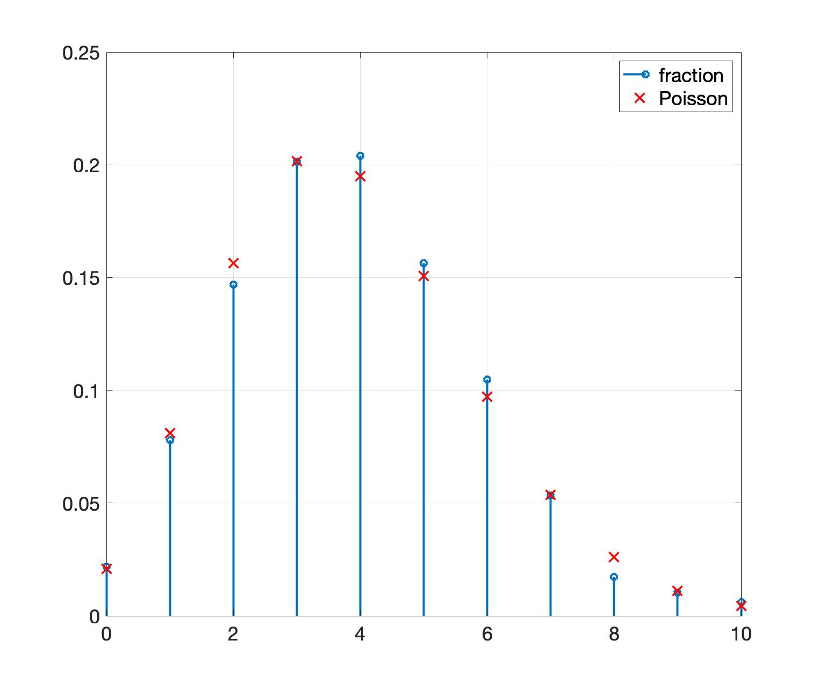
Poisson fit
Fraction of times k particles are emitted fits the Poisson model closely

Slide 5
Example: Fireballs (meteorites entering atmosphere)
In 276 months from 1994-2016, number of fireballs entering atmosphere is as follows:
#fireballs → 0 1 2 3 4 5 6 7 8 9 10
#times → 24 54 76 52 37 21 7 3 1 0 1
fraction → 0.087 0.196 0.275 0.188 0.134 0.076 0.025 0.0109 0.0036 0 0.0036
Arrival rate = (total number of fireballs) / 276 = 2.5217 (λ of Poisson)
Time of next arrival: independent of past
Poisson model: Prob(#fireballs = k) = e^{-λ} λ^{k} / k!
Fraction (given above) should be close to probability under Poisson model.

Slide 6
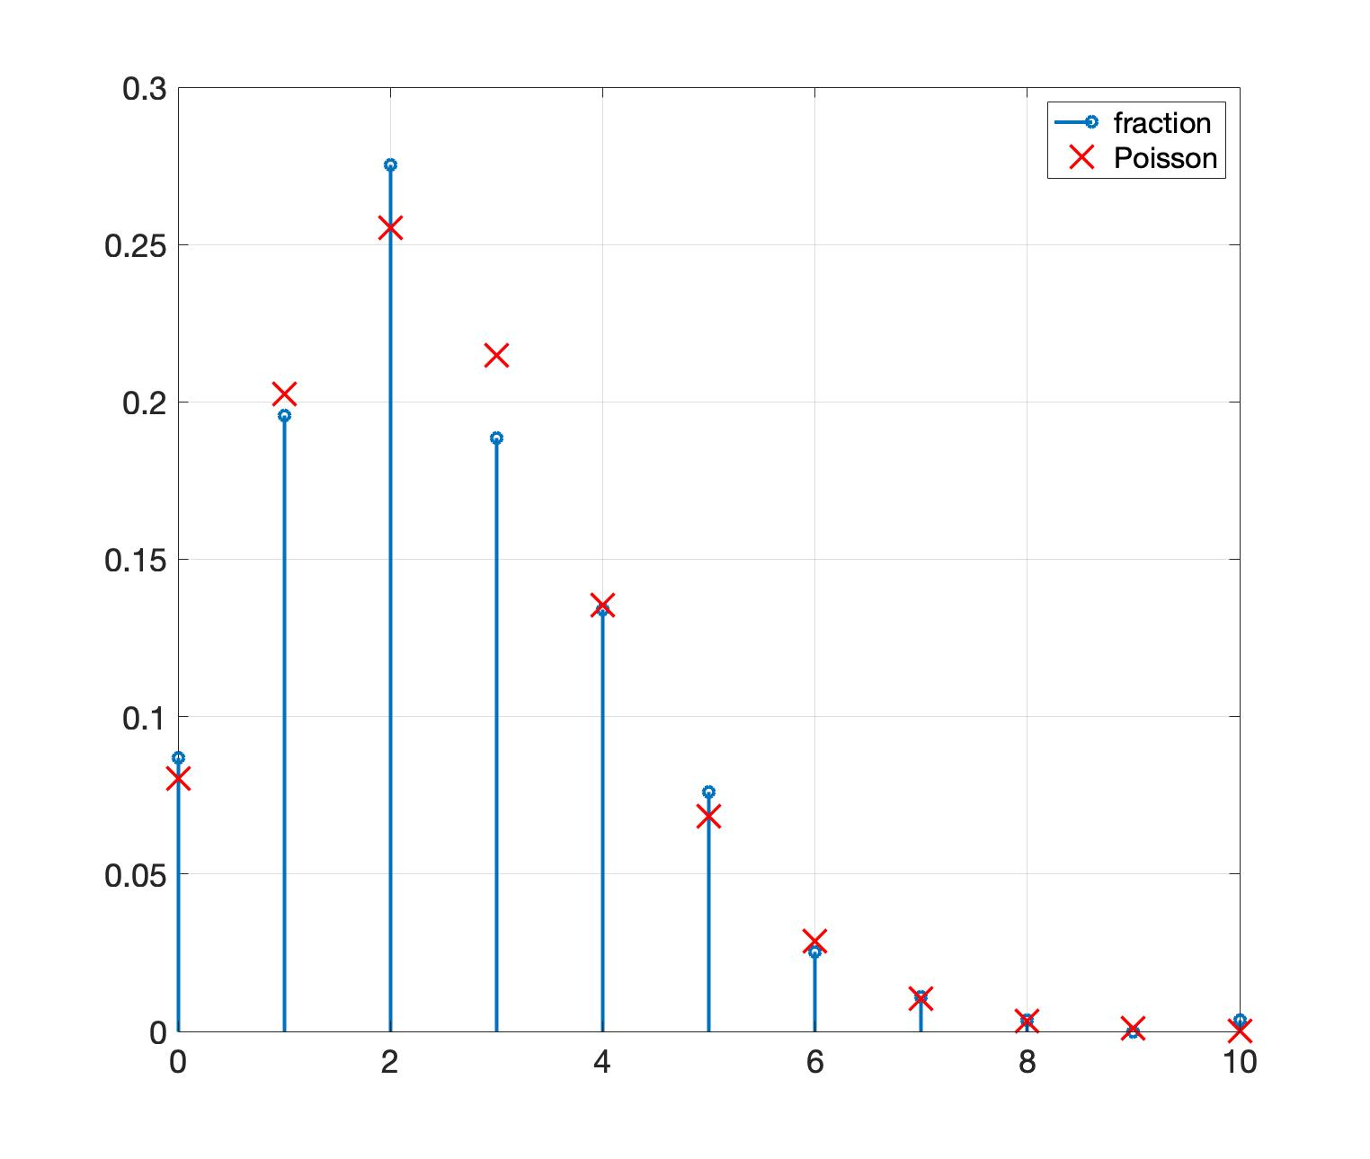
Poisson fit
Fraction of times k metoerites enter fits the Poisson model closely

Slide 7
Functions of one random variable

Slide 8
Functions of a random variable
X: a random variable with range T and PMF f_{X}(t)
X: function from sample space to T
T: subset of real line
Let f(x) be a function from real line to real line.
Then, f(X) can be seen as a composition of two functions.
So, f(X) is also a random variable in the same probability space.

Slide 9
Example
Let X ~ Uniform({ -2, -1, 0, 1, 2 }) and f(x) = x². Find the range and PMF of f(X).

Slide 10
Example
x for x < 5,
Let X ~ Geometric(0.5) and f(x) =
5 for x ≥ 5.
Find range and distribution of f(X).

Slide 11
General case
X: random variable with PMF f_{X}(t)
f(X): random variable whose PMF is given as follows.
f_{f(X)}(a) = P(f(X) = a) = P(X ∈ {t: f(t) = a})
= ∑_{t: f(t) = a} f_{X}(t)
PMF of f(X) can be found using PMF of X.

